Slide 1
Created By Godase U.R
New Satara College Of BCA,Pandharpur
Linux & Shell Programming

Slide 2
What Is Linux:-
Linux is an open-source operating system like other operating systems such as Microsoft Windows, Apple Mac OS, iOS, Google android, etc. An operating system is a software that enables the communication between computer hardware and software. It conveys input to get processed by the processor and brings output to the hardware to display it. This is the basic function of an operating system.

Slide 3
Evolution of Linux OS:-
The Linux OS was developed by Linus Torvalds in 1991, which sprouted as an idea to improve the UNIX OS. He suggested improvements but was rejected by UNIX designers. Therefore, he thought of launching an OS, designed in a way that could be modified by its users.
Nowadays, Linux is the fastest-growing OS. It is used from phones to supercomputers by almost all major hardware devices.

Slide 4
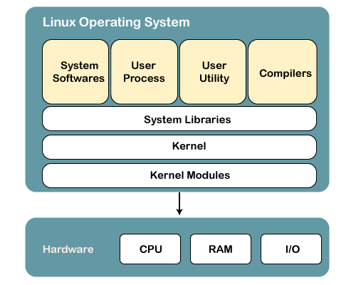
Structure Of Linux Operating System:-
An operating system is a collection of software, each designed for a specific function.
Linux OS has following components:

Slide 5
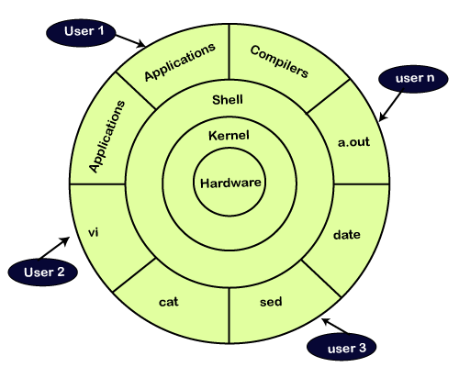
1) Kernel:-
Linux kernel is the core part of the operating system. It establishes communication between devices and software. Moreover, it manages system resources. It has four responsibilities:

Slide 6
device management:-
A system has many devices connected to it like CPU, a memory device, sound cards, graphic cards, etc. A kernel stores all the data related to all the devices in the device driver (without this kernel won't be able to control the devices). Thus kernel knows what a device can do and how to manipulate it to bring out the best performance. It also manages communication between all the devices. The kernel has certain rules that have to be followed by all the devices.
Memory management:
Another function that kernel has to manage is the memory management. The kernel keeps track of used and unused memory and makes sure that processes shouldn't manipulate data of each other using virtual memory addresses.
Process management:
In the process, management kernel assigns enough time and gives priorities to processes before handling CPU to other processes. It also deals with security and ownership information.
Handling system calls:
Handling system calls means a programmer can write a query or ask the kernel to perform a task.

Slide 7
2) System Libraries:-
System libraries are special programs that help in accessing the kernel's features. A kernel has to be triggered to perform a task, and this triggering is done by the applications. But applications must know how to place a system call because each kernel has a different set of system calls. Programmers have developed a standard library of procedures to communicate with the kernel. Each operating system supports these standards, and then these are transferred to system calls for that operating system.
3) System Tools:-
Linux OS has a set of utility tools, which are usually simple commands. It is a software which GNU project has written and publish under their open source license so that software is freely available to everyone.

Slide 8
4) Development Tools:-
With the above three components, your OS is running and working. But to update your system, you have additional tools and libraries. These additional tools and libraries are written by the programmers and are called toolchain. A toolchain is a vital development tool used by the developers to produce a working application.
5) End User Tools:-
These end tools make a system unique for a user. End tools are not required for the operating system but are necessary for a user.

Slide 9
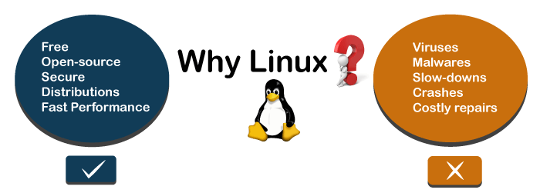
Why use Linux?:-
This is one of the most asked questions about Linux systems. Why do we use a different and bit complex operating system, if we have a simple operating system like Windows? So there are various features of Linux systems that make it completely different and one of the most used operating systems. Linux may be a perfect operating system if you want to get rid of viruses, malware, slowdowns, crashes, costly repairs, and many more. Further, it provides various advantages over other operating systems, and we don't have to pay for it. Let's have a look at some of its special features that will attract you to switch your operating system.

Slide 10
Linux Distributions:-
Many agencies modified the Linux operating system and makes their Linux distributions. There are many Linux distributions available in the market. It provides a different flavor of the Linux operating system to the users. We can choose any distribution according to our needs. Some popular distros are Ubuntu, Fedora, Debian, Linux Mint, Arch Linux, and many more.
For the beginners, Ubuntu and Linux Mint are considered useful and, for the proficient developer, Debian and Fedora would be a good choice. To Get a list of distributions, visit Linux Distributions
How does Linux work:-
Linux is a UNIX-like operating system, but it supports a range of hardware devices from phones to supercomputers. Every Linux-based operating system has the Linux kernel and set of software packages to manage hardware resources.
Also, Linux OS includes some core GNU tools to provide a way to manage the kernel resources, install software, configure the security setting and performance, and many more. All these tools are packaged together to make a functional operating system.

Slide 11
Linux Set Command:-
Linux set command is used to set and unset certain flags or settings within the shell environment. These flags and settings determine the behavior of a defined script and help in executing the tasks without facing any issue. The values of shell attributes and parameters can be changed or displayed by using the set command.
Syntax:
set [options]
Options: The supported options by the set command are as following:
-a: It is used to mark variables that are modified or created for export.
-b: It is used to notify of job termination immediately.
-e: It is used to exit immediately if a command exits with a non-zero status.
-f: It is used to disable the file name generation (globbing).
-h: It is used to save the location of commands where they looked up.
-k: It is used to place all assignment arguments in the environment variable of a command, except those that precede the command name.

Slide 12
Shell Variable:-
A variable is a character string that can hold a value. The assigned value could be anything such as number, filename, text, or any other data type. It is just like a pointer to the actual data. The shell allows us to create, delete, and assign variables.
The variable name can have any letters, numbers, or underscore (_) character. We cannot have the characters such as "! *, or -", because these special characters have other meanings for the shell. According to Unix naming convention, the Unix shell variable must have their names in UPPERCASE.

