Slide 1
NEW SATARA COLLEGE OF BCA PANDHARPUR
Operating System
Created By
Prof. Godase Ujwala .R

Slide 2
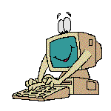
What is an Operating System?
The most important program that runs on your computer. It manages all other programs on the machine.
Every PC has to have one to run other applications or programs. It’s the first thing “loaded”.

Slide 3
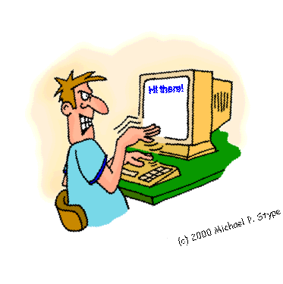
Operating System
It performs basic tasks, such as:
Recognizing input from the keyboard or mouse,
Sending output to the monitor,

Slide 4
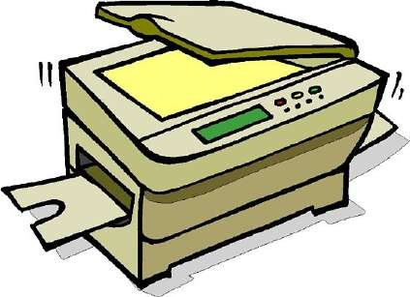
Operating System
Keeping track of files and directories on the disk, and
Controlling peripheral devices such as disk drives and printers.

Slide 5
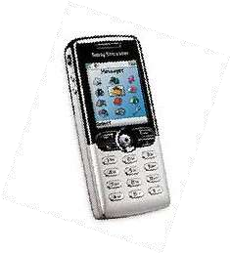
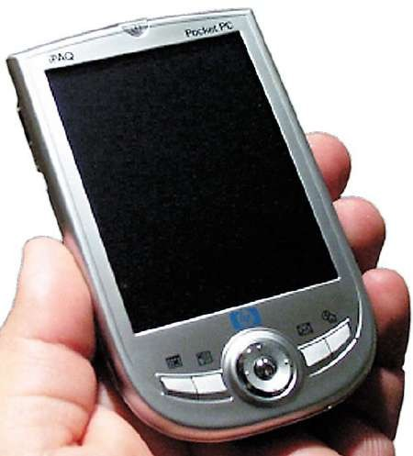
Is There More Than One Type of OS?
Generally, there are four types, based on the type of computer they control and the sort of applications they support.
Single-user, single task
This type manages the computer so that one user can effectively do one thing at a time.

Slide 6
Types of Operating Systems
2. Multi-user, multi-task
Allows two or more users to run programs at the same time. Some operating systems permit hundreds or even thousands of concurrent users.

Slide 7
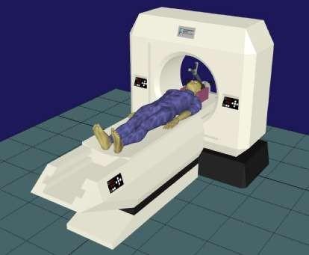
Types of Operating Systems
3. Real Time Operating Systems
RTOS are used to control machinery, scientific instruments, and industrial systems.
There is typically very little user- interface capability.
Resources are managed so that a particular operation executes precisely the same every time.

Slide 8
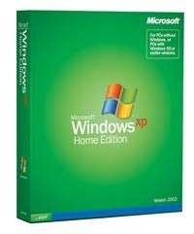
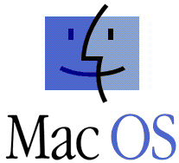
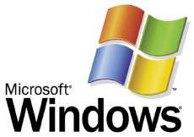
Types of Operating Systems
4. Single-user, Multi-tasking
This is the type of operating system most desktops and laptops use today.
Microsoft’s Windows and Apple’s MacOS are both examples of operating systems that will let a single user have several programs in operation at the same time.

Slide 9
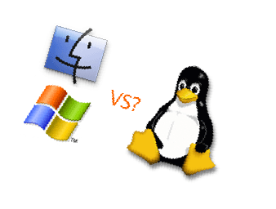
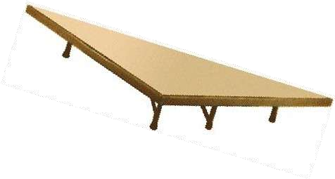
OS’s Manage Applications
Operating systems provide a software platform on top of which other “application” programs can run.
The application programs must be written to run on a particular operating system.
So, your choice of operating system determines what application software you can run.

Slide 10
Operating System Functions
Besides managing hardware and software resources on the system, the OS must manage resources and memory.
There are two broad tasks to be accomplished.

Slide 11
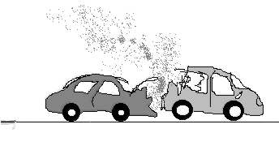
OS - Memory Storage and Management
1. Each process must have enough memory in which to execute, and
It can neither run into the memory space of another process,
Nor be run into by another process.

Slide 12
OS - Memory Storage and Management
1. The different types of memory in the system must be used properly so that each process can run most effectively.

Slide 13
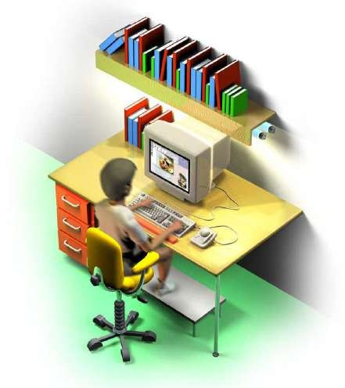
Cache Memory
Cache - A section of a computer's memory which temporarily retains recently accessed data in order to speed up repeated access to the same data.
It provides rapid access without having to wait for systems to load.

Slide 14
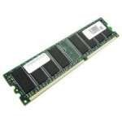
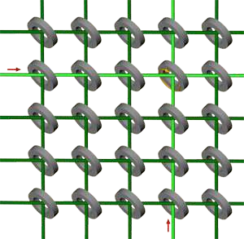
RAM Memory
Random access memory (RAM) is the best known form of computer memory.
RAM is considered "random access" because you can access any memory cell directly if you know the row and column that intersect at that cell.

Slide 15
RAM Memory
The more RAM your computer has, the faster programs can function. The two main types are called DRAM and SRAM. SRAM is faster than DRAM, but, more expensive.
Remember, that if the power is turned off, then all data left in RAM, that has not been saved to the hard drive, is lost.

Slide 16
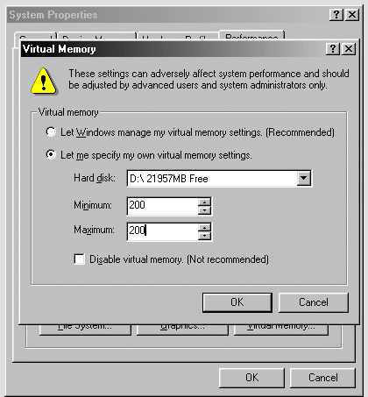
Virtual Memory
Virtual Memory – a method of using hard disk space to provide extra memory. It simulates additional RAM.
In Windows, the amount of virtual memory available, equals the amount of free RAM plus the amount of disk space allocated to the swap file.

Slide 17
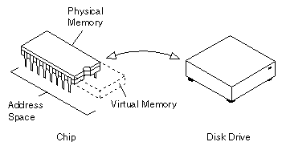
Virtual Memory – Swap File
A swap file is an area of your hard disk that is set aside for virtual memory. Swap files can be either temporary or permanent.

Slide 18
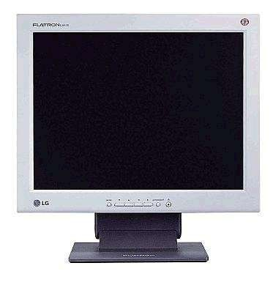
Okay – So Now What?

Slide 19
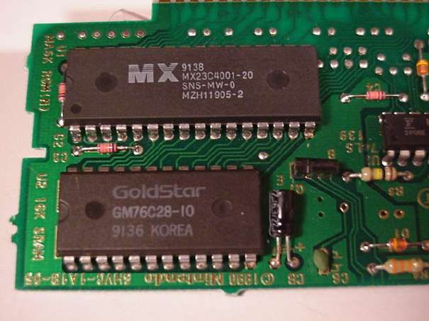
OS - Wake up call
When you turn on the power to a PC, the first program that runs is a set of instructions kept in the computer's read-only memory (ROM).

Slide 20
OS - Wake up Call
It checks to make sure everything is functioning properly.
It checks the CPU, memory, and basic input-output systems (BIOS) for errors.

Slide 21
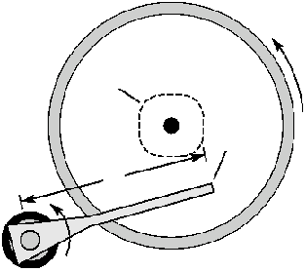
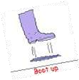
OS – Wake up Call
Once successful, the software will begin to activate the computer's disk drives.
It then finds the first piece of the operating system: the bootstrap loader.

Slide 22
OS - Booting the PC
The bootstrap loader is a small program that has a single function: It loads the operating system into memory and allows it to begin operation.

Slide 23
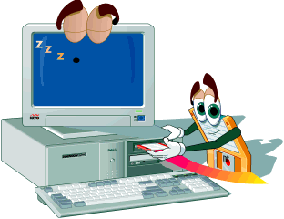
OS - Booting the PC
The bootstrap loader sets up the small driver programs that interface with and control the various hardware.
It sets up the divisions of
memory
user information, and
applications.

Slide 24
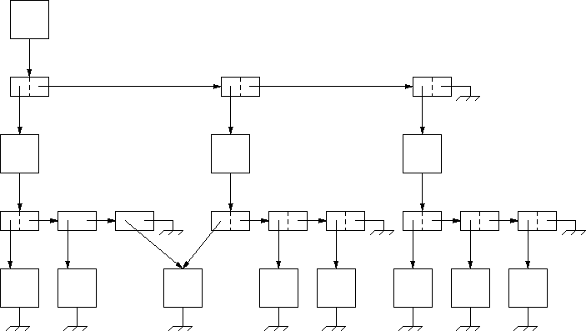
OS - Booting the PC
It establishes the data structures needed to communicate within and between the subsystems and applications of the computer.
Then it turns control of the computer over to the operating system.

Slide 25
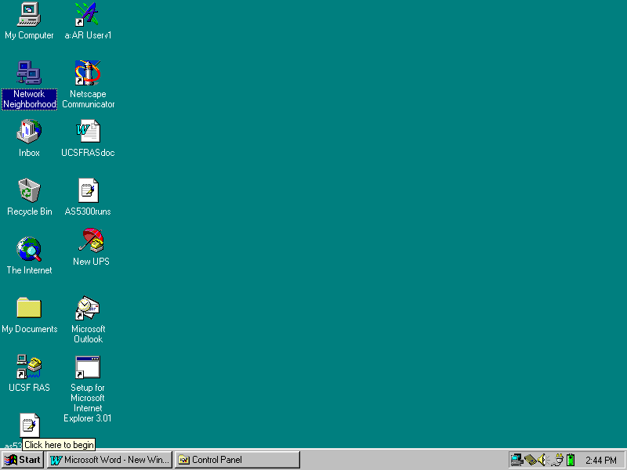
Windows Desktop
Your Desktop may look like this…

Slide 26
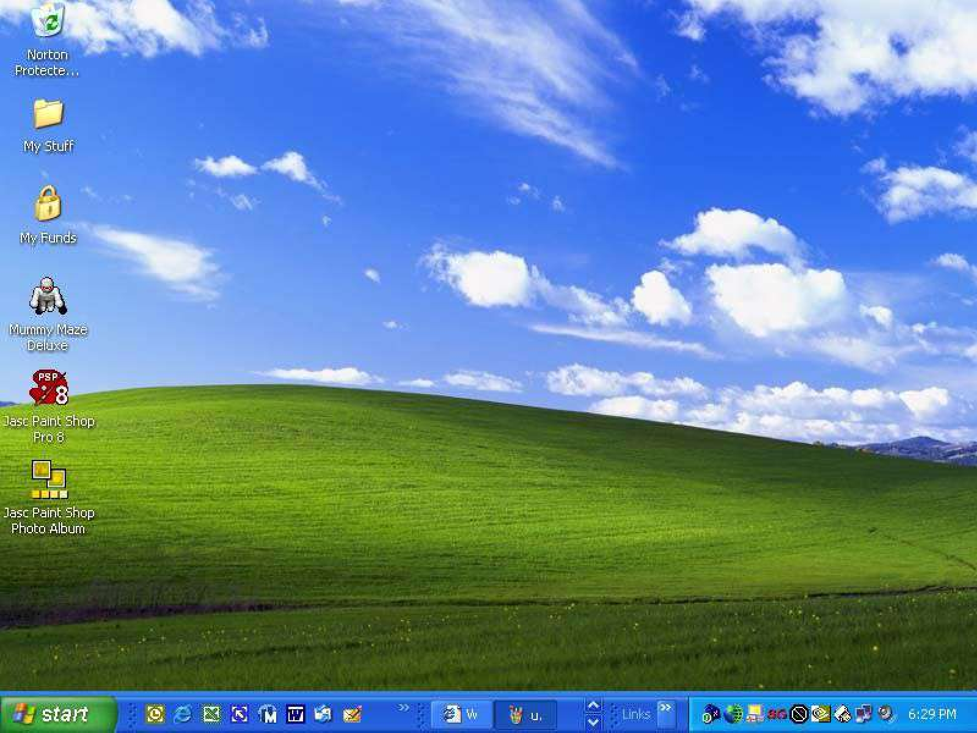
Windows Desktop
…Or like this.

Slide 27
How Do I Tell The OS What I Want To Do?
You must continue to give the operating system commands that are accepted and executed.
The first command was pushing the “ON” button which started the “boot” process.

Slide 28
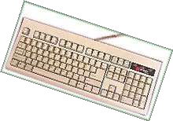
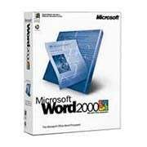
Enter Commands
Commands can be entered several ways:
Through a keyboard.
Pointing or clicking on an object with a mouse.
(Graphical User Interface or GUI)
Sending a command from another program.

Slide 29
Windows and Mac are GUI’s
Microsoft Windows and Apple Macintosh operating systems are “graphical user interfaces” or GUI’s.
GUI is defined as: A picture used in place of a word or words to issue commands.

Slide 30
GUI – Standards
GUI interfaces have standards that are usually the same or similar in all systems and applications.
Standards apply to:
Pointers and pointing devices
Icons, desktops, windows and menus

Slide 31
Windows - GUI Pointers
GUI uses pictures, symbols, or icons rather than words to represent some object or function. For example:
A pointer or mouse pointer is a small arrow or other symbol that moves on the screen as you move a mouse.
An I-Beam pointer is used by many desktop publishing systems and word processors to mark blocks of text and move the insertion point.

Slide 32
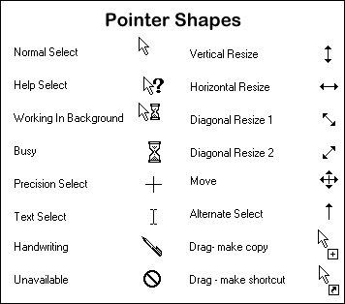
GUI – Cursors / Pointers
The term “cursor” typically is used to show where your typing will appear. Otherwise, the term “pointer” is the better choice.

Slide 33
Windows - GUI Icons
Icon - A small picture that represents a command, object, file, or window.
Point and click with a mouse to execute a command or convert the icon into a window.
Icons are moveable around the display screen, just like moving things around on your desk.

Slide 34
Object Icons & Shortcut Icons
One type of icon is an object icon. It allows you to open applications and documents on your PC.
You can create and use a shortcut icon to open any application quickly. You don’t have to use the Start Menu to access a program or document.

Slide 35
Windows - GUI Windows & Desktop
You can divide the screen into different areas.
In each window, you can run a different program or display a different file.
You can move windows around the display screen, and change their shape and size at will.

Slide 36
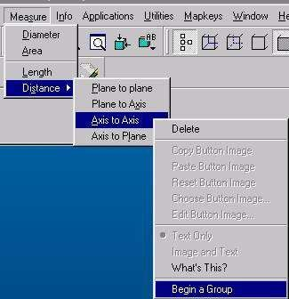
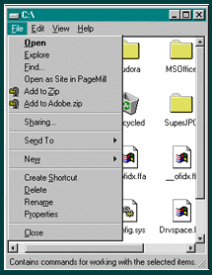
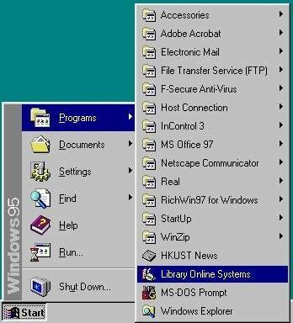
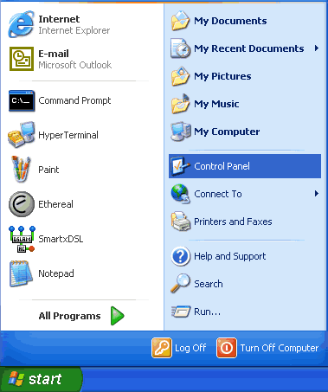
Windows - GUI Menus
Menu - is an on-screen list of options for using a program. It can also be a list of categories with many other menu options under it. Menus can "pop up" or "pull down."

Slide 37
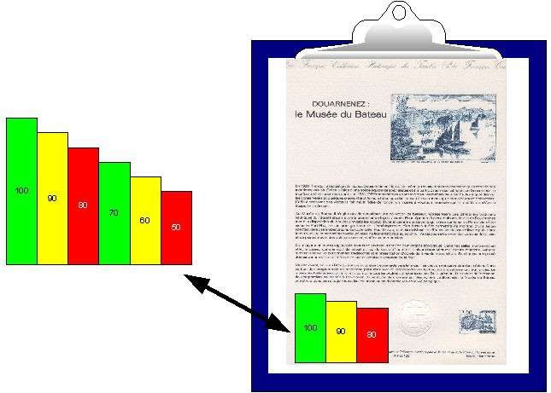
GUI – Share Data
Because the formats are well-defined, different programs that run under a common GUI can share data. This makes it possible, for example, to copy a graph created by a spreadsheet program into a document created by a word processor.

Slide 38
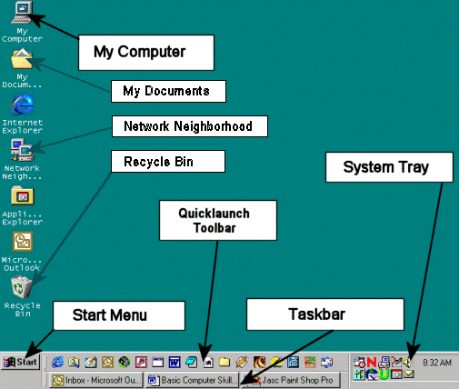
Parts of the Desktop

Slide 39
Windows - Taskbar
Taskbar – shows you the windows or programs that are currently open on the desktop. You can switch between windows by clicking on the applicable button.

Slide 40
Windows – System Tray
System Tray – shows you running programs that were started automatically by the operating system, like anti-virus programs, the clock and volume controls. These programs are running in the background.

Slide 41
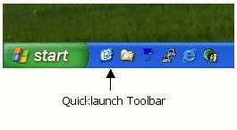
Windows - Quick Launch Toolbar
Quick Launch Toolbar – contains one-click buttons, or shortcuts, which open programs. You can customize this toolbar however you like.

Slide 42
Start Button
The start button allows you to easily access your computer programs or configure Windows. By default the start button is located at the bottom left side of the screen.

Slide 43
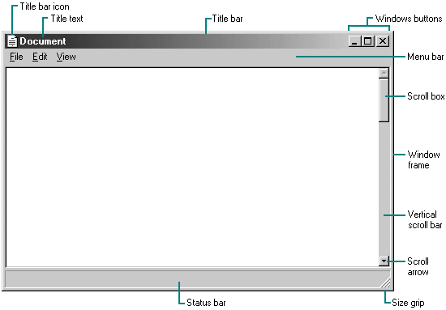
Parts of a Window

Slide 44
Title Bar
At the top edge of the window, inside its border, is the title bar which extends across the width of the window. It contains the title of the application or document.
A small icon in the far left corner of the title bar represents the object being viewed in the window.

Slide 45
Minimize, Maximize and Resize Windows
The title bar contains three little buttons in the upper right-corner of the window and are used to manage the window size or close it altogether.

Slide 46
Minimize - Maximize
The first button is the minimize button and it will hide the window. The window can be opened again by clicking its button on the taskbar.
The second button is maximize, which makes the window take up all the screen space. Clicking again turns the window back to the size it was. The double-box image is known as the restore button.

Slide 47
Close Window
The last button will close a window. If it is the last window of a certain type of program, it will exit or quit that program.

Slide 48
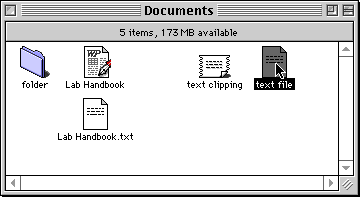
Move a Window
You can move a window to any location on the desktop by “clicking and dragging” the title bar with your mouse.
This is also referred to as “drag and drop”.
You can also drag and drop icons to move the location of files or shortcuts.

Slide 49
Menu Bar
Menu bar - The horizontal bar near the top of a window that displays the names of menus from which you can access features and perform tasks for the current application.

Slide 50
Types of Menu Items
Arrow: another menu will cascade from it.
Three dots: a dialog box will open, containing choices for you to make.

Slide 51
Types of Menu Items
Checkmark: clicking this item will toggle the feature on or off.
If a keyboard shortcut is shown in the menu, you can use those keys to run the command without having to open the menu.

Slide 52
Scroll Bar
Scroll bar - the narrow rectangular bar at the far right of windows.
Clicking on the up or down arrow enables you to move up and down through a document.
A movable square indicates your location in the document.

Slide 53
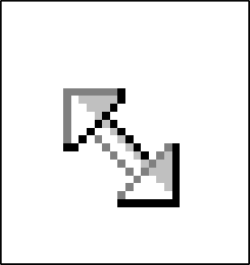
Windows Frame & Resizing
You can also resize a window by a click and drag move.
Put the mouse cursor on the edge of a window (that is not maximized) and when the pointer changes to a double arrow, click and drag for the new size. Some windows have a handle on them for resizing.

Slide 54
Status Bar
Status bar – is located at the bottom of a window and contains information about formatting options, errors, prompts, messages, or the status of an application.

Slide 55
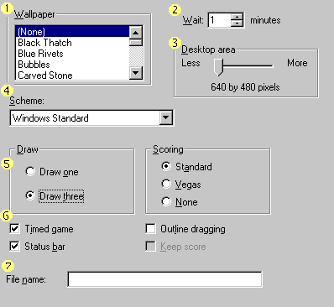
Dialog Boxes
List box
Spin control box
Slide
Drop-down list
Radio button
Checkbox
Text box

Slide 56
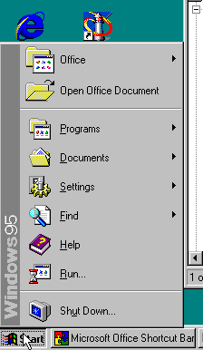
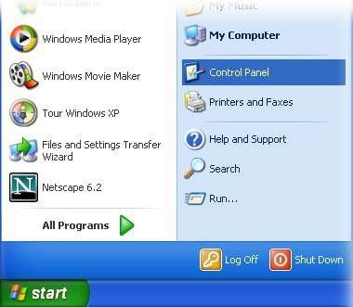
Windows – Start Menu
Start Menu – gives you access to all programs and functions on your PC, including “help” files and “search” capabilities.

Slide 57
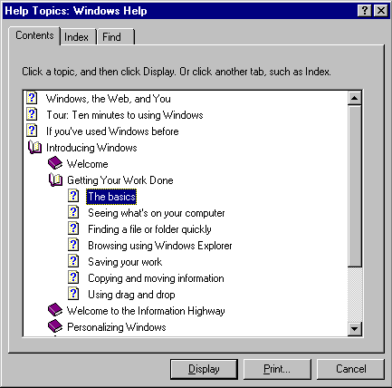
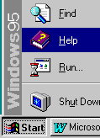
Windows HELP
Access Windows HELP through the Start menu.
Windows 95 HELP menu

Slide 58
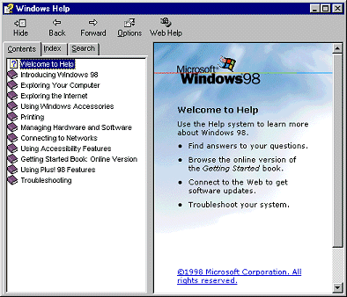
Windows HELP
Windows 98 HELP menu

Slide 59
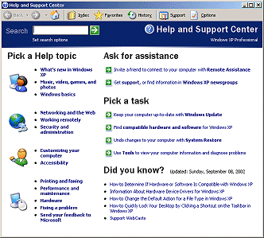
Windows HELP
Windows XP HELP menu

Slide 60
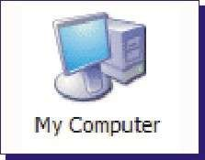
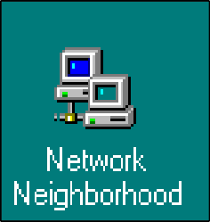
Windows System Programs
Windows has a number of internal programs as part of the operating system that help keep you organized and your PC healthy.
Here are a few:

Slide 61
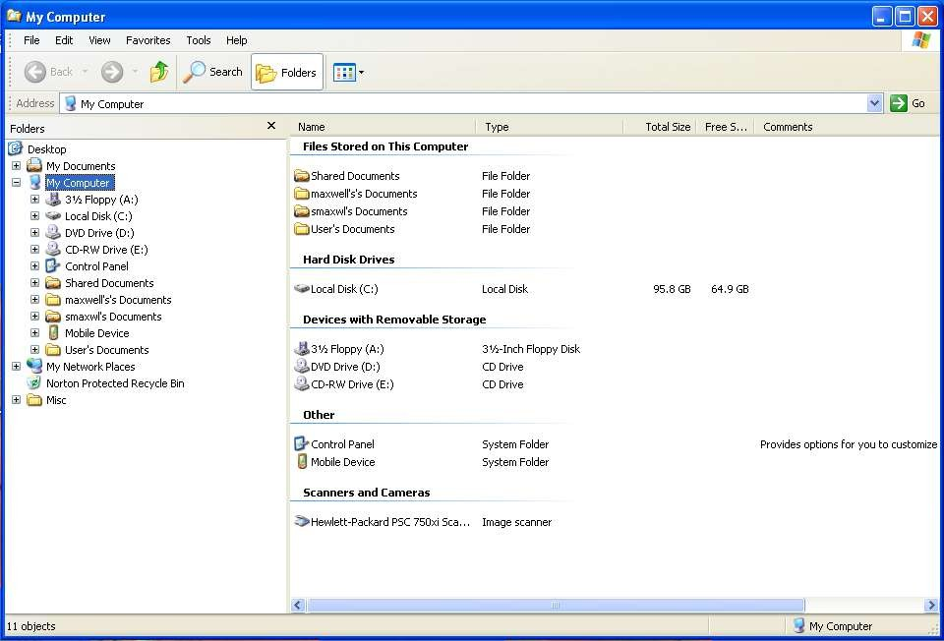
Windows - My Computer
Also known as
the Windows
Explorer
My Computer – inside this icon you can find every folder and file that your PC has access to.

Slide 63
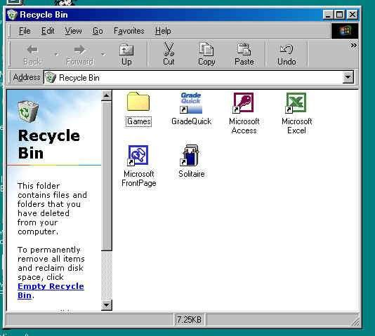
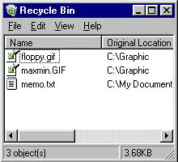
Windows – Recycle Bin
Recycle Bin – Deleted files and folders go here first, where they wait to be permanently deleted by you, or by rules that you set up. This is a temporary storage area on your hard drive.

Slide 64
Windows – My Docs
My Documents – a place to store the documents and files you create. Clicking on this opens an explorer window displaying the detail.
It’s wise to keep the files you create separate from the program files, so when you backup your data, it’s all located in one location. You can then backup just this area of your storage.

Slide 65
My Documents – Explorer Window

Slide 66
Windows – Network Neighborhood
Network Neighborhood – serves as a window into the network resources you have on your PC.
If you are connected to a network you will see all the other PC’s linked to your network and you can share files, printers or other hardware.

Slide 67
Network Neighborhood

Slide 68
Logoff
If your have multiple users on a PC with separate “profiles” or user logons, use the logoff process to close out of your profile or to switch users.

Slide 69
Shutdown Windows
There is a “graceful” way of shutting down your PC that will save your program settings and files.
This shutdown process basically puts the operating system to bed.

Slide 70
Which Explorer?
Tip: Don't confuse Windows Explorer with Internet Explorer.
Windows Explorer is the program that lets you explore things "inside" your own computer.
Internet Explorer lets you explore things "outside" your computer -- namely things on the Internet.

