Slide 1
New satara College Of BCA,Pandharpur
Data Warehousing &Data Mining
Created By
Prof.Godase U.R

Slide 2
Introduction :-
A data warehouse is constructed by integrating data from multiple heterogeneous sources. It supports analytical reporting, structured and/or ad hoc queries and decision making. This tutorial adopts a step-by-step approach to explain all the necessary concepts of data warehousing.
The term "Data Warehouse" was first coined by Bill Inmon in 1990. According to Inmon, a data warehouse is a subject oriented, integrated, time-variant, and non-volatile collection of data. This data helps analysts to take informed decisions in an organization.
An operational database undergoes frequent changes on a daily basis on account of the transactions that take place. Suppose a business executive wants to analyze previous feedback on any data such as a product, a supplier, or any consumer data, then the executive will have no data available to analyze because the previous data has been updated due to transactions.
A data warehouses provides us generalized and consolidated data in multidimensional view. Along with generalized and consolidated view of data, a data warehouses also provides us Online Analytical Processing (OLAP) tools. These tools help us in interactive and effective analysis of data in a multidimensional space. This analysis results in data generalization and data mining.
Data mining functions such as association, clustering, classification, prediction can be integrated with OLAP operations to enhance the interactive mining of knowledge at multiple level of abstraction. That's why data warehouse has now become an important platform for data analysis and online analytical processing.

Slide 3
Difference between operational database systems and data warehouse:-
Key | Operational database | Data warehouse
Basic | Operational Database are those databases where data changes frequently | A data warehouse is a repository for structured, filtered data that has already been processed for a specific purpose
Data Structure | It has normalized schema | Data warehouse has denormalized schema
Performance | It is slow for analytics queries | It is fast for analysis queries
Type of Data | It focuses on current transactional data | It focuses on historical data
Uses Case | It is used for OLTP | It is used for OLAP

Slide 4
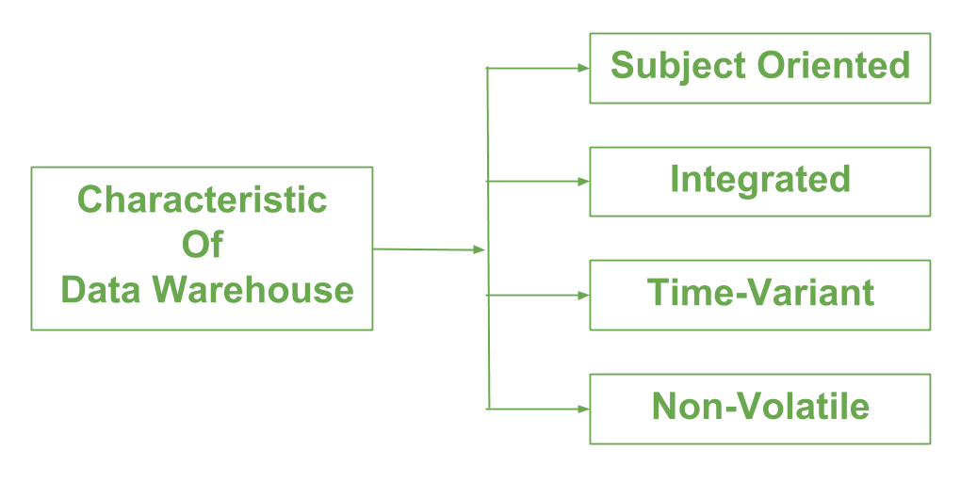
Data warehouse Characteristics:-

Slide 5
Subject Oriented −
A data warehouse is subject oriented because it provides information around a subject rather than the organization's ongoing operations. These subjects can be product, customers, suppliers, sales, revenue, etc. A data warehouse does not focus on the ongoing operations, rather it focuses on modelling and analysis of data for decision making.
Integrated −
A data warehouse is constructed by integrating data from heterogeneous sources such as relational databases, flat files, etc. This integration enhances the effective analysis of data.
Time Variant −
The data collected in a data warehouse is identified with a particular time period. The data in a data warehouse provides information from the historical point of view.
Non-volatile −
Non-volatile means the previous data is not erased when new data is added to it. A data warehouse is kept separate from the operational database and therefore frequent changes in operational database is not reflected in the data warehouse.

Slide 6
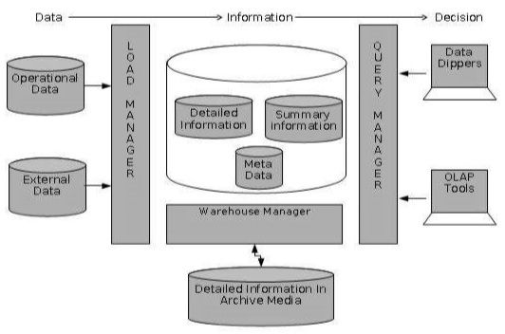
Data warehousse Architecture and its Components:-
The data aggregated to the next level of detail and then archived to tape. The detailed information part of data warehouse keeps the detailed information in the starflake schema. Detailed information is loaded into the data warehouse to supplement the aggregated data.
The following diagram shows a pictorial impression of where detailed information is stored and how it is used.

Slide 7
Operational data :-
An operational data store is a type of database that acts as a central repository for the data collected from different sources connected to the given data warehouse system.
Load Manager:-
This component performs the operations required to extract and load process.
The size and complexity of the load manager varies between specific solutions from one data warehouse to other.
Load Manager Architecture:-
The load manager performs the following functions −
Extract the data from source system.
Fast Load the extracted data into temporary data store.
Perform simple transformations into structure similar to the one in the data warehouse.
size and complexity of the load manager varies between specific solutions from one data warehouse to other.
Load Manager Architecture:-
The load manager performs the following functions −
Extract the data from source system.
Fast Load the extracted data into temporary data store.
Perform simple transformations into structure similar to the one in the data warehouse.

Slide 8
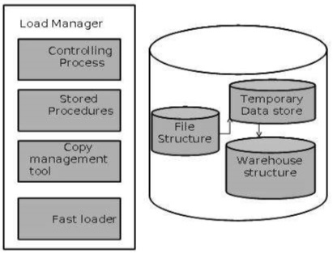

Slide 9
Detailed Information:-
Detailed information is not kept online, rather it is aggregated to the next level of detail and then archived to tape. The detailed information part of data warehouse keeps the detailed information in the starflake schema. Detailed information is loaded into the data warehouse to supplement the aggregated data.
Summary Information:-
Summary Information is a part of data warehouse that stores predefined aggregations. These aggregations are generated by the warehouse manager. Summary Information must be treated as transient. It changes on-the-go in order to respond to the changing query profiles.
The points to note about summary information are as follows −
Summary information speeds up the performance of common queries.
It increases the operational cost.
It needs to be updated whenever new data is loaded into the data warehouse.
It may not have been backed up, since it can be generated fresh from the detailed information.
to note about summary information are as follows −
Summary information speeds up the performance of common queries.
It increases the operational cost.
It needs to be updated whenever new data is loaded into the data warehouse.
It may not have

Slide 10
Metadata:-
Metadata is simply defined as data about data. The data that is used to represent other data is known as metadata. For example, the index of a book serves as a metadata for the contents in the book. In other words, we can say that metadata is the summarized data that leads us to detailed data. In terms of data warehouse, we can define metadata as follows.
Metadata is the road-map to a data warehouse.
Metadata in a data warehouse defines the warehouse objects.
Metadata acts as a directory. This directory helps the decision support system to locate the contents of a data warehouse.

